Slide 1

Distributed Cloud Computing
EL2 - Paper Presentation

Slide 2


SmartCMP: A Cloud Cost Optimization Governance Practice
Cloud computing has become a key technology driving innovation and development in the information industry. As the global economy continues to decline, enterprises are focusing more on optimizing operations and reducing costs. However, the cost and investment in cloud infrastructure have become critical factors affecting the competitiveness of enterprise cloud businesses. The SmartCMP platform provides a comprehensive solution for cloud cost analysis and optimization to help enterprises address these challenges.

Slide 3
Challenges in Cloud Cost Optimization
1
Resource Waste
2
Billing Complexity
Enterprises often struggle to identify and optimize wasted cloud resources, lacking effective resource optimization methods.
Cloud billing data is huge and complex, and enterprises lack professional tools for data visualization and analysis.
3
Hybrid Cloud Management
4
Organizational Challenges
In a hybrid cloud environment, it is difficult to meter and bill cloud resources uniformly across multiple platforms.
Cloud resource management lacks clear measurement standards and organizational processes, making it difficult to govern cloud costs effectively.

Slide 4

The FinOps Approach
Resource Allocation
Continuous Optimization
Attribute cloud resources to different projects, departments, and owners to establish clear cost ownership and accountability.
Implement automated policies to continuously monitor, detect, and optimize cloud resources to reduce costs and ensure compliance.
1
2
3
Cost Analysis
Conduct unified data analysis and visualization of cloud costs from multiple perspectives to identify optimization opportunities.

Slide 5
Key Components of SmartCMP
Unified Cloud Management
Flexible Billing
Cost Optimization
The platform supports defining custom billing rules for any type of cloud or non-cloud resource, enabling enterprises to allocate costs accurately across the organization.
SmartCMP's intelligent optimization engine continuously monitors cloud resources and automates optimization actions, such as shutting down idle resources or adjusting resource configurations.
SmartCMP provides the capability to encapsulate and manage resources from multiple cloud platforms, including public and private clouds, in a unified manner.

Slide 6
Unified Cloud Cost Management
Multi-Cloud Integration
Granular Cost Allocation
SmartCMP integrates with multiple public cloud platforms, as well as private cloud and on-premises resources, to provide a comprehensive view of an enterprise's cloud costs.
The platform supports allocating cloud costs to specific departments, projects, and individuals, enabling enterprises to understand the true cost of their cloud usage.
Customizable Dashboards
Automated Reporting
Enterprises can create customized dashboards to visualize cloud costs from different perspectives, such as by cost center, resource type, or organizational structure.
SmartCMP generates automated cost reports and alerts, helping enterprises stay on top of their cloud spending and identify optimization opportunities.

Slide 7
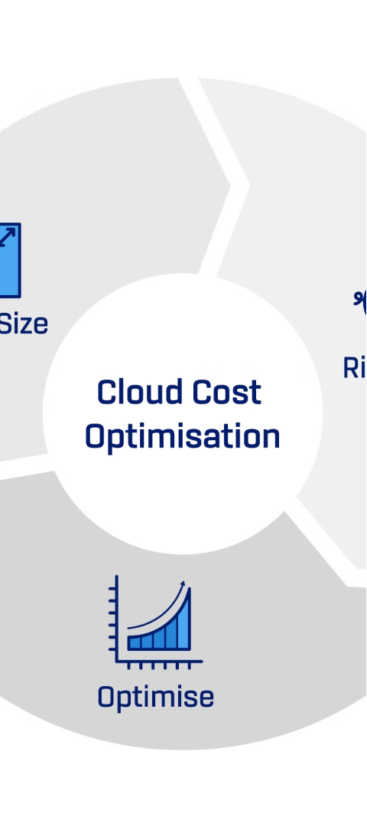



Intelligent Cost Optimization
Policy-Driven Optimization
SmartCMP's cost optimization engine applies predefined policies to identify and address issues such as idle resources, over-provisioned instances, and non-compliant configurations.
Automated Remediation
The platform can automatically take actions to optimize cloud resources, such as shutting down unused instances, scaling down resources, or adjusting resource types.
Continuous Monitoring
SmartCMP continuously monitors cloud resources and costs, providing real-time alerts and recommendations to help enterprises maintain optimal cloud usage and cost efficiency.

Slide 8



Compliance and Security
Resource Compliance
Threat Detection
Audit Trails
SmartCMP checks cloud resources for compliance with security policies, such as exposed ports or unauthorized configurations, and can automatically remediate issues.
The platform monitors cloud resources for potential security threats, such as suspicious activity or unauthorized access, and triggers alerts and mitigation actions.
SmartCMP maintains detailed audit logs of all cloud resource changes and cost-related activities, enabling enterprises to meet regulatory and compliance requirements.

Slide 9
Benefits of SmartCMP
Unified Cloud Management
Centralized visibility and control over cloud resources across multiple platforms
Granular Cost Allocation
Accurate attribution of cloud costs to specific departments, projects, and individuals
Automated Optimization
Continuous monitoring and optimization of cloud resources to reduce waste and improve efficiency
Compliance and Security
Proactive monitoring and remediation of cloud resource compliance and security issues
Improved Decision-Making
Detailed cost analysis and reporting to support informed cloud investment and usage decisions

Slide 10
Customer Success Story
Unified Cloud Management
Automated Cost Optimization
Improved Visibility and Control
A large FMCG company with multiple cloud platforms and a complex organizational structure was able to achieve unified management of its cloud resources through SmartCMP, gaining a comprehensive view of its cloud costs and usage.
The platform's intelligent optimization engine continuously monitored the company's cloud resources, automatically identifying and remediating issues such as idle resources and over-provisioned instances, resulting in significant cost savings.
By allocating cloud costs to specific departments, projects, and individuals, the company was able to improve cost accountability and make more informed decisions about its cloud investments and usage.

Slide 11
Conclusion
As the adoption of multi-cloud strategies continues to grow, ensuring efficient cloud cost management has become a critical priority for enterprises. The SmartCMP platform provides a comprehensive solution for cloud cost analysis, optimization, and governance, helping enterprises overcome the challenges of cloud cost management and unlock the full potential of their cloud investments. By integrating financial, operational, and security capabilities, SmartCMP empowers enterprises to take control of their cloud costs, improve decision-making, and drive greater business value from their cloud deployments.

